Slide 1
Data Augmentation for Graph Neural Networks
AAAI_2021
Code:github.com/zhao-tong/GAug
2021.01.23 • ChongQing
Reported by Chenghong Li

Slide 2
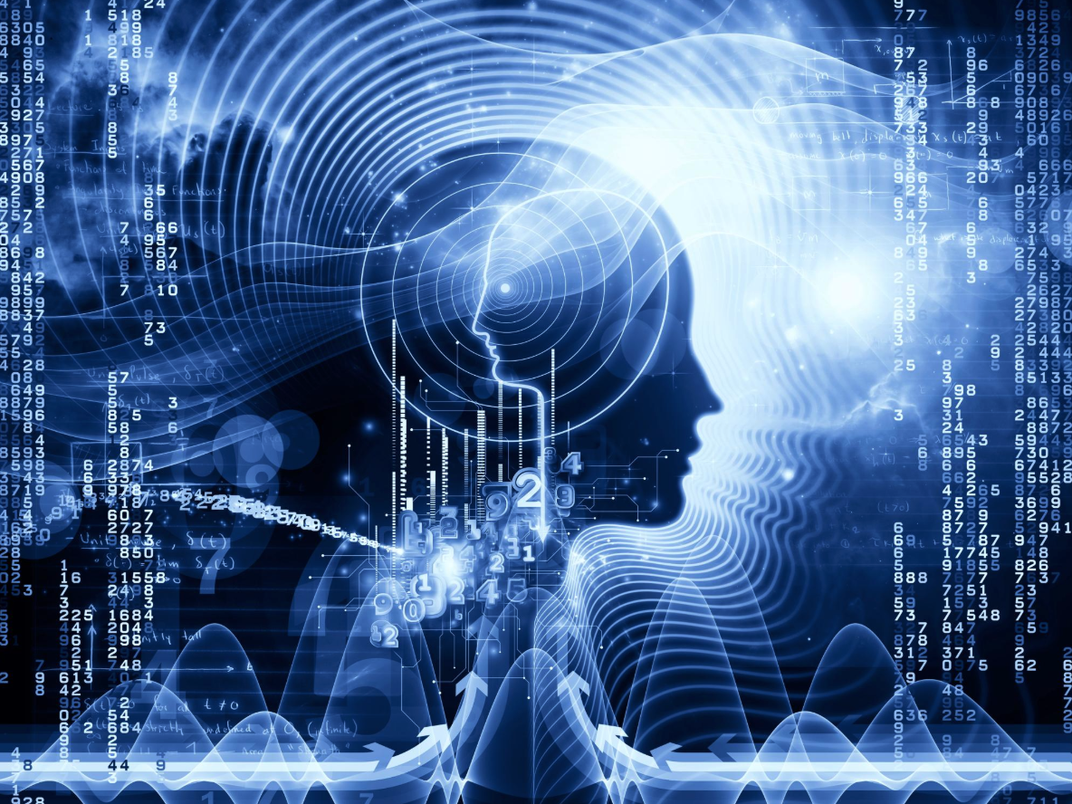
1. Introduction
2. Method
3. Experiments
4. Conclusion

Slide 3
Introduction
Many graphs in the real world are susceptible to noise.
For node classification tasks, adding nodes poses challenges in labeling and imputing features and connectivity of new nodes, while removing nodes simply reduces the data available.
Thus, edge addition and removal appears the best augmentation strategy for graphs.
We discuss how facilitating message passing by removing "noisy" edges and adding "missing" edges that could exist in the original graph.

Slide 4
Introduction

Slide 5
Method
GAUG-M for the Modified-Graph Setting
Each GCN layer (GCL) is definedas:

Slide 6
Method
GAUG-O for the Orginal-Graph Setting

Slide 7
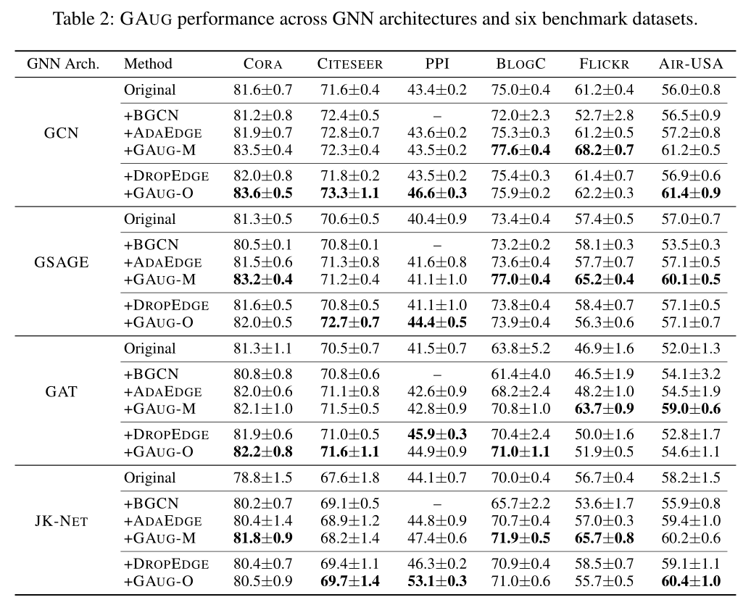
Experiments

Slide 8
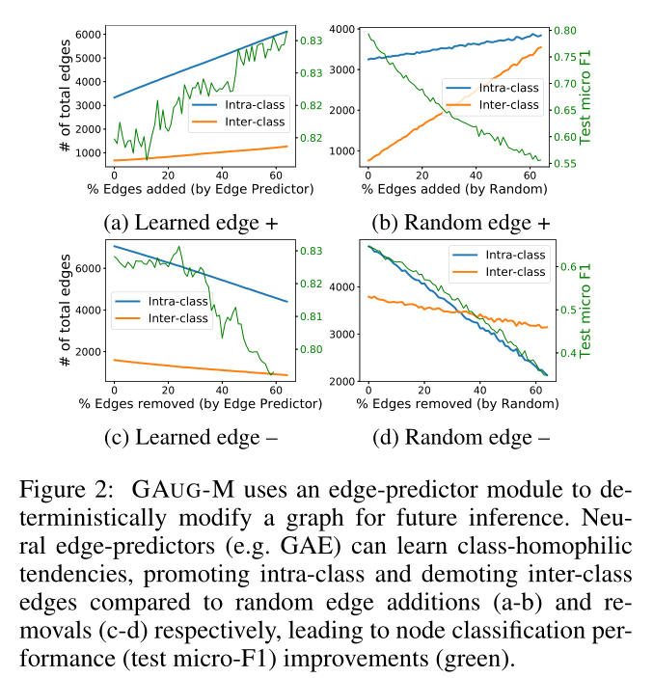
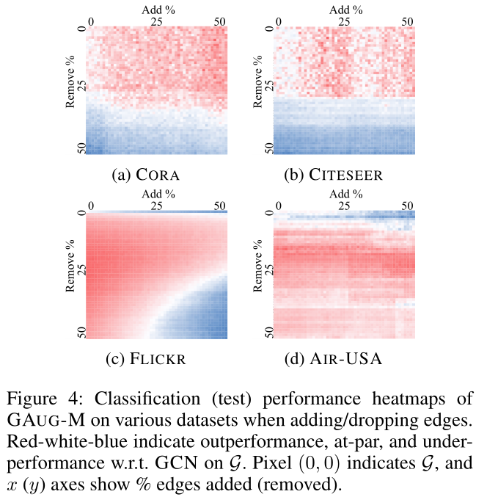
Experiments

Slide 9
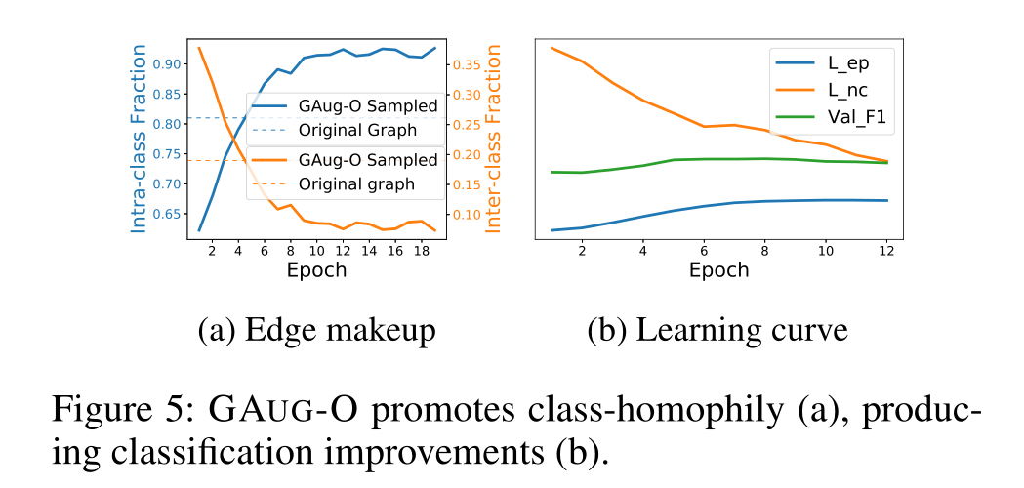
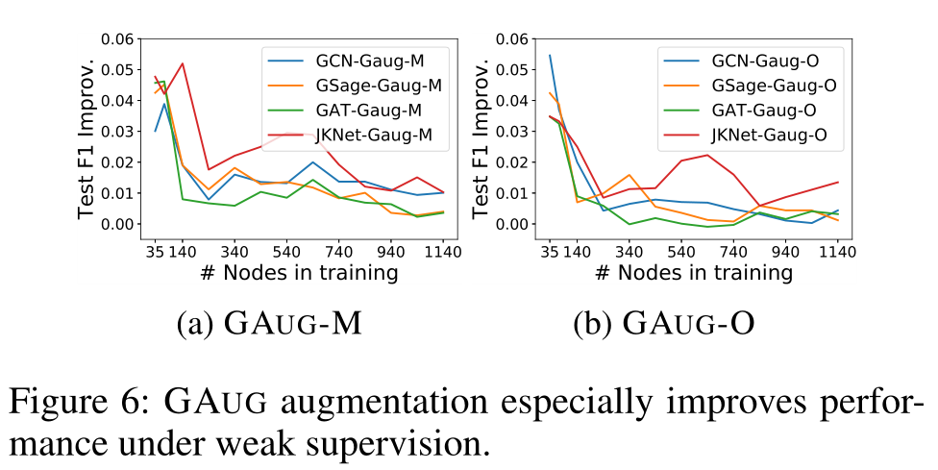
Experiments

